Slide 1
OBSTACLE AVOIDING ROBOT USING ULTRASONIC SENSOR
Team Impulse:
S.V. Sahithi
B. Keerthana
P. Sreeja
V. Bhavani

Slide 2
What is Obstacle Avoiding Robot??
Obstacle Avoiding Robot is an intelligent device that can automatically sense the obstacle in front of it and avoid them by turning itself in another direction. This design allows the robot to navigate in an unknown environment by avoiding collisions, which is a primary requirement for any autonomous mobile robot.

Slide 3
Hardware Required:
Arduino Uno
Ultrasonic Sensor – HC – SR04
Motor Driver IC – L293D
Servo Motor (Tower Pro SG90)
Geared Motors x 2
Robot Chassis
Power Supply
Battery Connector
Battery Holder

Slide 4
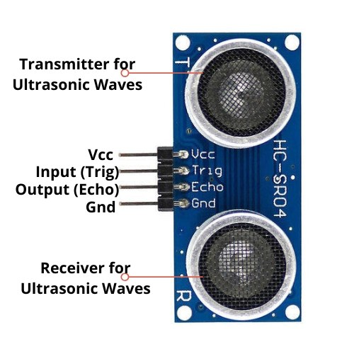
Introduction to Ultrasonic sensor:
It is an Ultrasonic Range Finder Sensor. It is a non-contact based distance measurement system and can measure distance of 2cm to 4m.

Slide 5
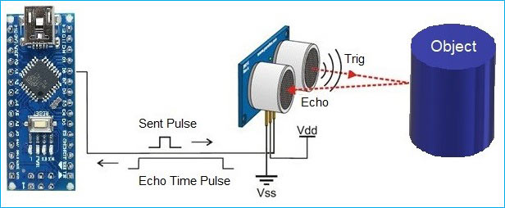
Working of Ultrasonic Sensor:
The basic principle behind the working of ultrasonic sensor is to note down the time taken by sensor to transmit ultrasonic beams and receiving the ultrasonic beams after hitting the surface.
Then further the distance is calculated using the formula.
The Trig pin of HC-SR04 is made high for at least 10 us. A sonic beam is transmitted with 8 pulses of 40KHz each.
The signal then hits the surface and return back and captured
by the receiver Echo pin of HC-SR04. The Echo pin had already
made high at the time sending high.
The time taken by beam to return back is saved in variable and
converted to distance using appropriate calculations like below:

Slide 6
The time taken by beam to return back is saved in variable and converted to distance using appropriate calculations like below
Distance= (Time x Speed of Sound in Air (343 m/s))/2

Slide 7
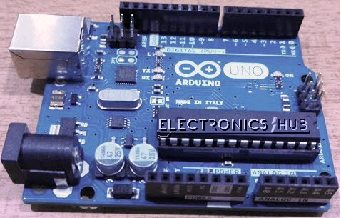
Arduino Uno :
Arduino Uno is an ATmega 328p Microcontroller based prototyping board. It is an open source electronic prototyping platform that can be used with various sensors and actuators.
Arduino Uno has 14 digital I/O pins out of which 6 pins are used in this project.

Slide 8
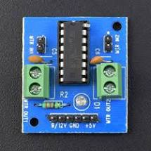
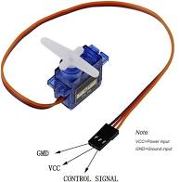
L293D :
It is a motor driver which can provide bi-directional drive current for two motors.
Servo Motor :
The Tower Pro SG90 is a simple Servo Motor which can rotate 90 degrees in each direction (approximately 180 degrees in total).

Slide 9
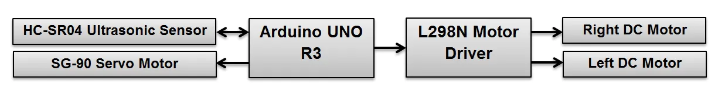
Block Diagram

Slide 10
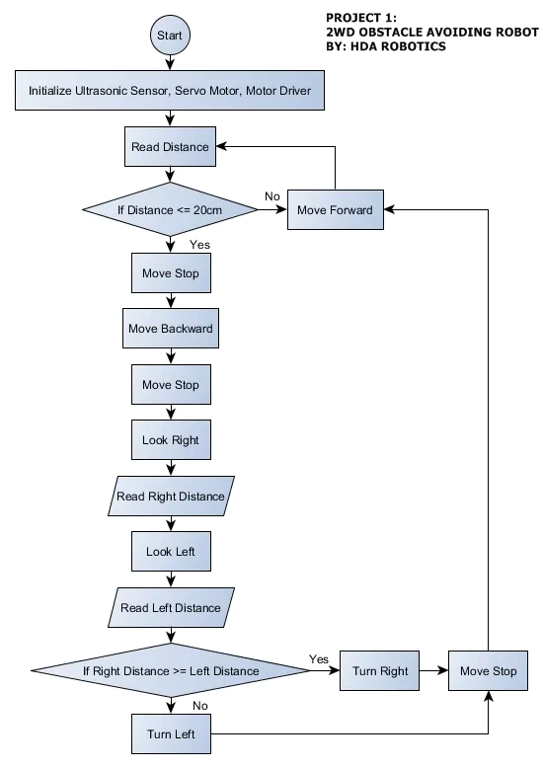
Algorithm/Flowchart Diagram

Slide 11
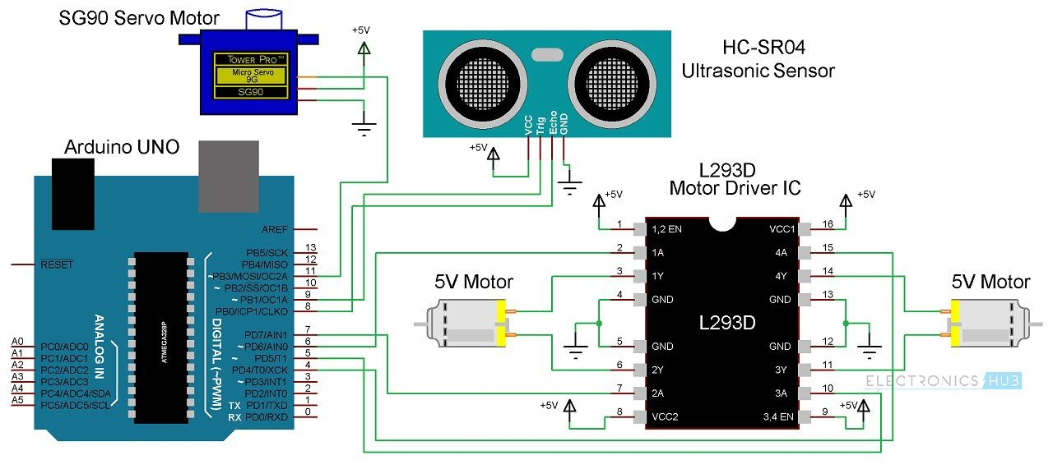
Circuit Diagram:

Slide 12
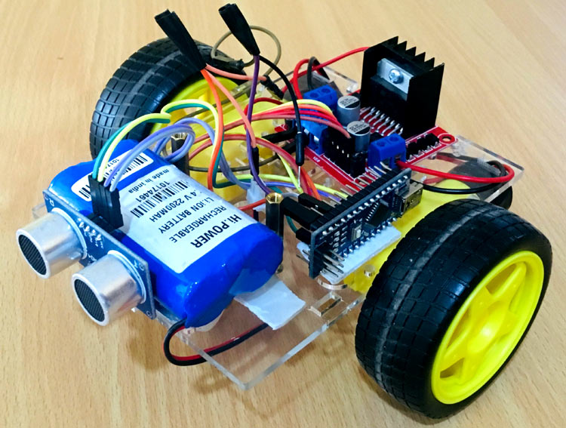
Obstacle Avoiding Robot

Slide 13
Applications:
Obstacle avoiding robots can be used in almost all mobile robot navigation systems.
They can be used for household work like automatic vacuum cleaning.
They can also be used in dangerous environments, where human penetration could be fatal.

Slide 14
THANK YOU
- Team Impulse

